Slide 1
Azure AI Agent Orchestration
EMEA AI GBB X-Pod

Slide 2


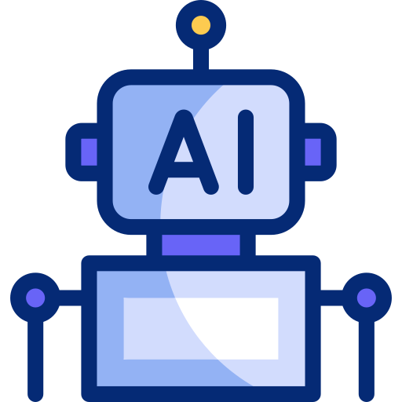
Single Azure AI Agent with Foundry SDK
Azure
(Azure AI Agent Service)
Foundry Agent
User

Slide 3
Single Azure AI Agent with Semantic Kernel
Local or Azure
Azure
(Azure AI Agent Service)
SK
Agent
Foundry Agent
User
SK Agents can be created as wrappers around the Azure AI Agent with the class AzureAIAgent

Slide 4
Azure AI Connected Agents
Azure
(Azure AI Agent Service)
Orchestrator Agent
User
Foundry Agent
Foundry Agent
Foundry Agent

Slide 5


Azure AI Agent with Semantic Kernel and Plugins
Local or Azure
Azure
(Azure AI Agent Service)
Plugins are executed in the same compute as SK –
after the Foundry Agent function call
SK
Agent
Foundry Agent
User
The Foundry Agent decides on which plugin to call using Function Calling
Other Domain
SK Plugin calls
SQL Server to retrieve data

Slide 6




Azure AI Agent with Semantic Kernel and Azure Tools
Local or Azure
Azure
(Azure AI Agent Service)
Logic Apps Tool
SK
Agent
Foundry Agent
User
Plugins run in the same compute as SK –
after the Foundry Agent function call
Grounding with Bing
OpenAPI Tool
Internet
Web Service

Slide 7
Azure AI Agents with SK Sequential Orchestrator
Local or Azure
Azure
(Azure AI Agent Service)
Foundry Agent
Orchestrator SK Agent
Foundry Agent
User
Plugins run in the same compute as SK –
after the Foundry Agent function call
Foundry Agent

Slide 8
Azure AI Agents with SK Concurrent Orchestrator
Local or Azure
Azure
(Azure AI Agent Service)
Foundry Agent
Orchestrator
SK Agent
Foundry Agent
User
Plugins run in the same compute as SK –
after the Foundry Agent function call
Foundry Agent

Slide 9
Azure AI Agents with SK Orchestrator
Local or Azure
Azure
(Azure AI Agent Service)
Foundry Agent
Orchestrator SK Agent
Foundry Agent
User
Plugins run in the same compute as SK –
after the Foundry Agent function call
Foundry Agent

Slide 10

Single Azure AI Agent with Voice Live API
Azure Speech
Azure
(Azure AI Agent Service)
Voice
Azure
Speech
Text
Foundry Agent
User
Voice Live API
Azure Speech Voice Live API integrated with the Azure AI Agent service

Slide 11
Azure AI Agents with Routing
Local or Azure
Azure
(Azure AI Agent Service)
Foundry Agent
Orchestrator SK Agent
Foundry Agent
Router Agent
User
SK
Agent
Foundry Agent

Slide 12
Thank You!

